Slide 1
Place value in decimals
Place value

Slide 2
how to use Oak lessons

Slide 3
I can state place value in decimals, including recognising exponent and fractional representations of the column headings.

Slide 4
A number is in decimal form when the decimal point is shown and there are digits to the right of the decimal point.
Example
12.475
Example
395.2905
Example
0.23
Non-example
23

Slide 5

Place value in decimals
Exponential and fractional forms for decimals
Different representations of decimals

Slide 6





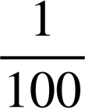
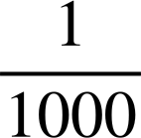
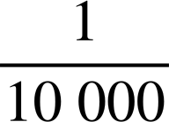
Exponential and fractional forms for decimals
A decimal is a number that has parts that are not whole. The place value chart splits whole numbers into tenths, hundredths, thousandths, and so on.
7
9
2
2
5
8
The decimal point is placed at the right of the ones column. Each column after the decimal point is a decimal place.

Slide 7
Exponential and fractional forms for decimals
A decimal is a number that has parts that are not whole. The place value chart splits whole numbers into tenths, hundredths, thousandths, and so on.
7
9
2
2
5
8
This shows the decimal has two tenths.
This shows the decimal has five hundredths.

Slide 8
Exponential and fractional forms for decimals
A decimal is a number that has parts that are not whole. The place value chart splits whole numbers into tenths, hundredths, thousandths, and so on.
7
9
2
2
5
8
What does this represent?

Slide 9
Exponential and fractional forms for decimals
A decimal is a number that has parts that are not whole. The place value chart splits whole numbers into tenths, hundredths, thousandths, and so on.
7
9
2
2
5
8
This shows the decimal has 8 thousandths.

Slide 10
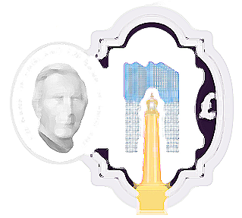
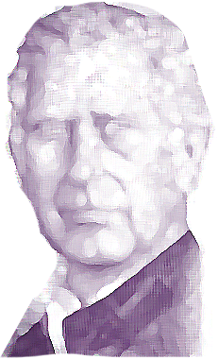

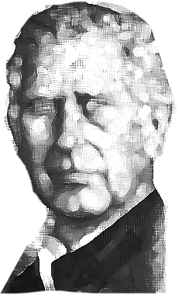
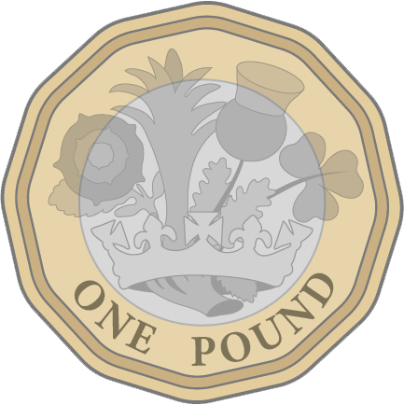

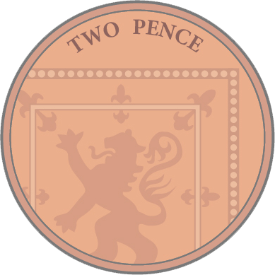
Exponential and fractional forms for decimals
How would you pronounce this amount of money?
£20
20
£20
20
£20
20
£20
20
£20
20
£20
20
How would this look in the place value chart?
£20
20
£20
20
£20
20
£10
10
£10
10
£10
10

Slide 11
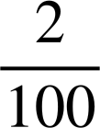
Exponential and fractional forms for decimals
Place value chart
of one pound is 10p
of one pound is 2p
2
1
3
1
2
One tenth
Two hundredths

Slide 12
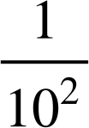
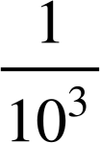
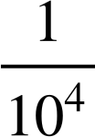
Exponential and fractional forms for decimals
Place value charts can have different headings, but are equivalent.
Exponents in the column heading

Slide 13
Exponential and fractional forms for decimals
Place value chart
Exponents in the column heading
Exponents in the column heading

Slide 14




Exponential and fractional forms for decimals
Place value chart
Decimal equivalent in the column heading

Slide 15
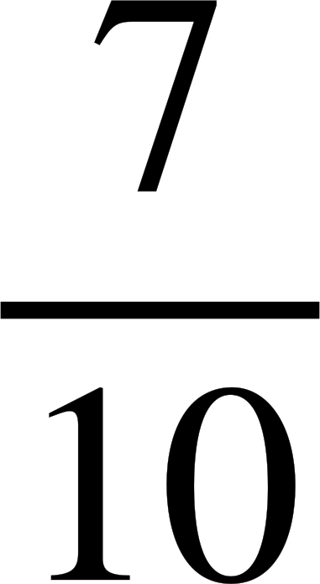

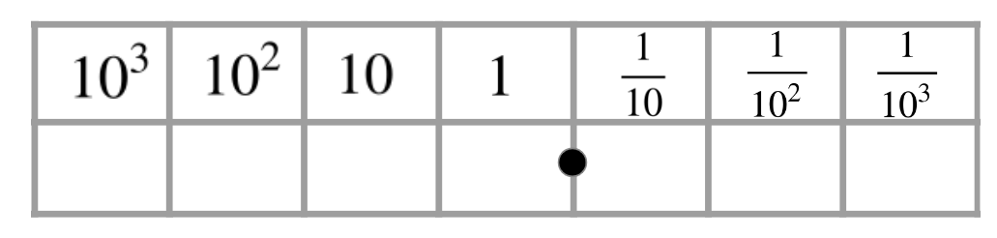
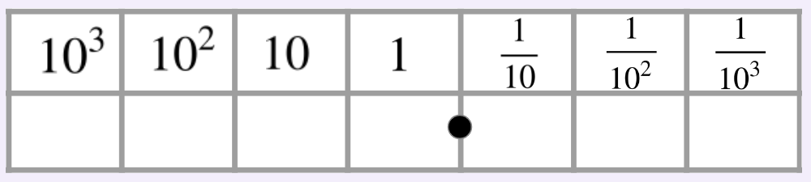
Exponential and fractional forms for decimals
Give an example of a decimal with exactly four hundredths.
Give an example of a decimal having and
You can use the place value chart if it helps.
You can use the place value chart if it helps.
7
1
9
3
4
1
5
2
4
1
7
5
There are an infinite number of solutions.
Ensure there is a 4 in the hundredths column heading.
There are an infinite number of solutions.
Ensure there is a 7 in the tenths column and a 5 in the 10³ column.

Slide 16
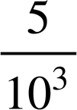
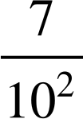
Exponential and fractional forms for decimals
Identify the decimals which have:
a)
b)
c)
d)
Exactly 3 tenths :
Exactly :
Exactly :
Exactly zero hundredths:

Slide 17



Exponential and fractional forms for decimals
Fill in the gaps so that each column shows a different way of writing the same value.
In fractional form
In decimal form
In exponent form
In words | one tenth | one hundredth

Slide 18

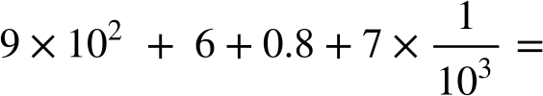

Exponential and fractional forms for decimals
2) Write the following in decimal form.
a)
b)
c)
d)

Slide 19



Exponential and fractional forms for decimals
Fill in the gaps so that each column shows a different way of writing the same value.
In fractional form
In decimal form
In exponent form
In words | one tenth | one hundredth | one thousandth | one ten thousandth

Slide 20
Exponential and fractional forms for decimals
2) Write the following in decimal form.
a)
b)
c)
d)
2304.9
2000
300
4
0.9
8004.72
8000
4
0.7
0.02
906.807
900
6
0.8
0.007
2040.409
2000
40
0.003
0.4
0.006

Slide 21
Place value in decimals
Exponential and fractional forms for decimals
Different representations of decimals

Slide 22
Different representations of decimals
Place value in decimals can be represented in different ways using different place value charts.
It is important to understand how these place value charts work.

Slide 23
Different representations of decimals
Here is a Gattegno chart.
1000 |  | 2000 |  | 3000 |  | 4000 |  | 5000 |  | 6000 |  | 7000 |  | 8000 |  | 9000
100 |  | 200 |  | 300 |  | 400 |  | 500 |  | 600 |  | 700 |  | 800 |  | 900
10 |  | 20 |  | 30 |  | 40 |  | 50 |  | 60 |  | 70 |  | 80 |  | 90
1 |  | 2 |  | 3 |  | 4 |  | 5 |  | 6 |  | 7 |  | 8 |  | 9
0 | .1 | 0 | .2 | 0 | .3 | 0 | .4 | 0 | .5 | 0 | .6 | 0 | .7 | 0 | .8 | 0 | .9
0 | .01 | 0 | .02 | 0 | .03 | 0 | .04 | 0 | .05 | 0 | .06 | 0 | .07 | 0 | .08 | 0 | .09

Slide 24
Different representations of decimals
Can you identify the decimal represented here?
1000 |  | 2000 |  | 3000 |  | 4000 |  | 5000 |  | 6000 |  | 7000 |  | 8000 |  | 9000
100 |  | 200 |  | 300 |  | 400 |  | 500 |  | 600 |  | 700 |  | 800 |  | 900
10 |  | 20 |  | 30 |  | 40 |  | 50 |  | 60 |  | 70 |  | 80 |  | 90
1 |  | 2 |  | 3 |  | 4 |  | 5 |  | 6 |  | 7 |  | 8 |  | 9
0 | .1 | 0 | .2 | 0 | .3 | 0 | .4 | 0 | .5 | 0 | .6 | 0 | .7 | 0 | .8 | 0 | .9
0 | .01 | 0 | .02 | 0 | .03 | 0 | .04 | 0 | .05 | 0 | .06 | 0 | .07 | 0 | .08 | 0 | .09
643.62

Slide 25
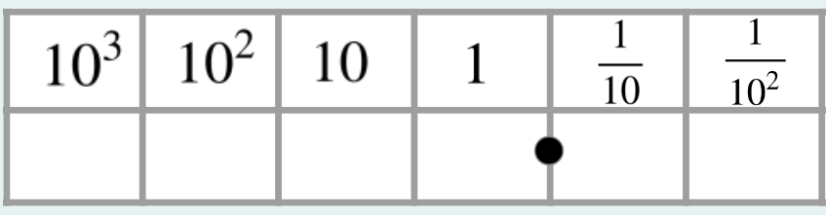


Different representations of decimals
Which has the largest decimal value? Explain.
200 |  | 600 |  | 800
20 |  | 60 |  | 80
2 |  | 6 |  | 8
0 | .2 | 0 | .6 | 0 | .8
0 | .02 | 0 | .06 | 0 | .08
2
8
6
8
2
2
8
6
2
8
The hundreds, tens and ones are the same for both decimals, but the Gattegno chart shows 2 tenths and 8 hundredths which is less than 8 tenths and 2 hundredths.

Slide 26
1) Complete the charts to make the decimals.
751.15
262.26
93.191
Different representations of decimals
100 |  | 500 |  | 700
10 |  | 50 |  | 70
1 |  | 5 |  | 7
0 | .1 | 0 | .5 | 0 | .7
0 | .01 | 0 | .05 | 0 | .07
200 |  | 600
20 |  | 60
2 |  | 6
0 | .2 | 0 | .6
0 | .02 | 0 | .06

Slide 27
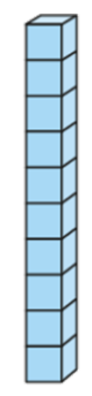
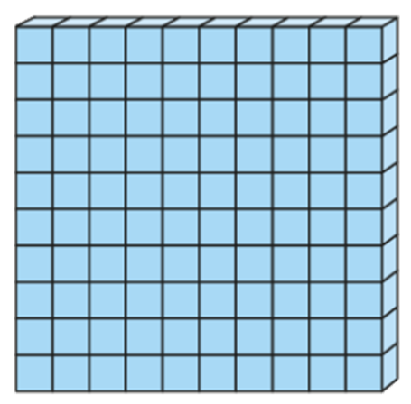

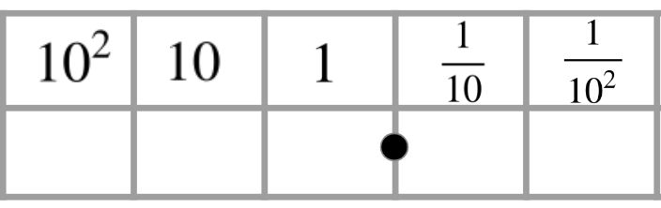
Sofia
Alex
Laura
2) Three students have different numbers.
Insert all the digits 6, 5, 4 and 2 into Sofia’s place value chart to make:
a) a decimal greater than Laura’s.
b) a decimal less than Alex’s.
c) a decimal in between Alex’s number and Laura’s number.
Try to find more than one answer for each.
Different representations of decimals
200 |  | 500
20 |  | 50
2 |  | 5
0 | .2 | 0 | .5

Slide 28
1) Complete the charts to make the decimals.
751.15
262.26
93.191
Different representations of decimals
100 |  | 500 |  | 700
10 |  | 50 |  | 70
1 |  | 5 |  | 7
0 | .1 | 0 | .5 | 0 | .7
0 | .01 | 0 | .05 | 0 | .07
200 |  | 600
20 |  | 60
2 |  | 6
0 | .2 | 0 | .6
0 | .02 | 0 | .06
10 |  | 30 |  | 90
1 |  | 3 |  | 9
0 | .1 | 0 | .3 | 0 | .9
0 | .01 | 0 | .03 | 0 | .09
0 | .001 | 0 | .003 | 0 | .009

Slide 29
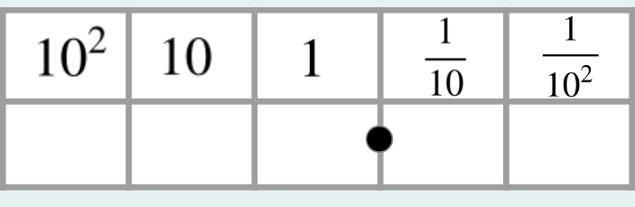
a) a decimal greater than Laura’s.
6
5
4
2
2
5
6
4
Alex has 234
Laura has 255.2
6
4
5
2
Different representations of decimals
Example answers
200 |  | 500
20 |  | 50
2 |  | 5
0 | .2 | 0 | .5

Slide 30
b) a decimal less than Alex’s.
5
4
2
6
2
6
4
5
Alex has 234
Laura has 255.2
6
4
2
5
Different representations of decimals
Example answers
200 |  | 500
20 |  | 50
2 |  | 5
0 | .2 | 0 | .5

Slide 31
c) a decimal in between Alex’s number and Laura’s number.
2
5
4
6
2
4
5
6
Alex has 234
Laura has 255.2
Different representations of decimals
Only two answers
200 |  | 500
20 |  | 50
2 |  | 5
0 | .2 | 0 | .5

Slide 32
Place value in decimals
A decimal can be represented by using exponentials in the column headings of a place value chart.
Decimals can be represented by using fractions in the column headings of a place value chart.
Place value charts have different column headings which can express a decimal in different ways.

Slide 33

© Oak National Academy 2023.
Produced in partnership with Mathematics in Education and Industry.
Licensed on the Open Government Licence v3.0, except where otherwise stated. See Oak terms and conditions.

